Slide 1
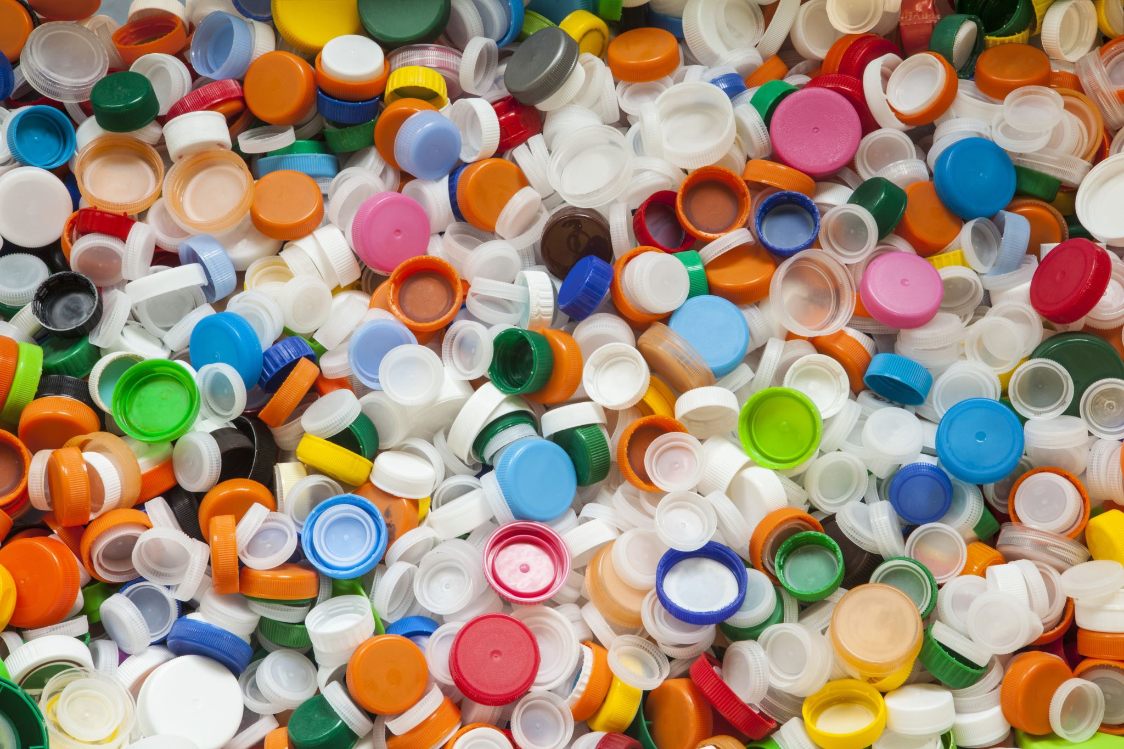
Plastic Waste Management (PWM) Rules, 2016 &
Extended Producer Responsibility (EPR)

Slide 2







Legal Framework
Draft notification, 2021
Environment Protection Act , 1986
Amendment Rules, 2018
Plastic Waste Management Rules, 2016 (PWM)
Bio Medical Waste Management Rules, 2016
Extended
E- Waste Management Rules, 2016
Producer Responsibility
FORM1 and Registration
WASTE MANAGEMENT RELATED RULES, 2016
Extended
Producer
Responsibility
Consent to Operate –
Take back Action plan
Construction and Demolition Waste Management Rules, 2016
Hazardous & Other Waste (Management & Transboundary Movement) Rules, 2016
Solid Waste
Management Rules, 2016 (SWM)
Air and
Glass, Tin,
Plastic,
Paper etc.
Water Act – Consent to Operate

Slide 3
The Evolution of PWM Rules and EPR
Recycled Plastics Manufacture, Sale and Usage Rules, 1999
Focus area was carry bags only
> 20 micron thickness criterion
Amended in 2003
Draft Plastic (Manufacture, Usage and Waste Management) Rules,2009
Emphasis on plastic carry bags and MLP only
>40 micron criterion
Introduced concept of EPR and responsibility of brand owners
EPR obligation introduced
FORM 1 for Brands introduced
>50 micron
Carry bags, MLP, plastic sheets or
Plastic Waste (Management and
handling Rules), 2011
Plastic Waste Management Rules 2016
like
Amended in 2018
Amended in 2021- Prohibition of certain SUPs and carry bag thickness >75 micro from 30.09.2021 and thickness > 120 micron from 31.12.2022

Slide 4
PWM Rules 2016 & as amended 2018 & 2021
Objective: -
To give thrust on
Plastic waste minimization,
Source segregation,
Recycling,
Involving waste pickers,
Recyclers and waste processors in collection of plastic waste fraction either from household or any other source of its generation
Intermediate material recovery facility and adopt polluter’s pay principle for the sustainability of the waste management system.
5

Slide 5
Definition
Producer | : | Persons engaged in manufacture or import of carry bags or multi- layered packaging or plastic sheets or like and includes industries.
Manufacturer | : | Production of plastic raw material to be used as raw material by the producer.

Slide 6
Definition
Institutional waste generator | : | institutional buildings such as Central Government Departments, State Government Departments, public or private sector companies, hospitals, schools, colleges, universities or other places of education, organisation, academy, hotels, restaurants, malls and shopping complexes
Brand Owner Importer | : : | A person or company who sells any commodity under a registered brand label. A person who imports or intends to import and holds an Importer- Exporter Code number, unless otherwise specifically exempted.

Slide 7
Definition
Plastic | : | Material which contains as an essential ingredient a high polymer such as Polyethylene terephthalate, High density polyethylene, Vinyl, low density polyethylene, Polypropylene, Polystyrene resins, Multi-materials like acrylonitrile butadiene styrene, Polyphenylene oxide, Polycarbonate, Polybutylene terephthalate.

Slide 8
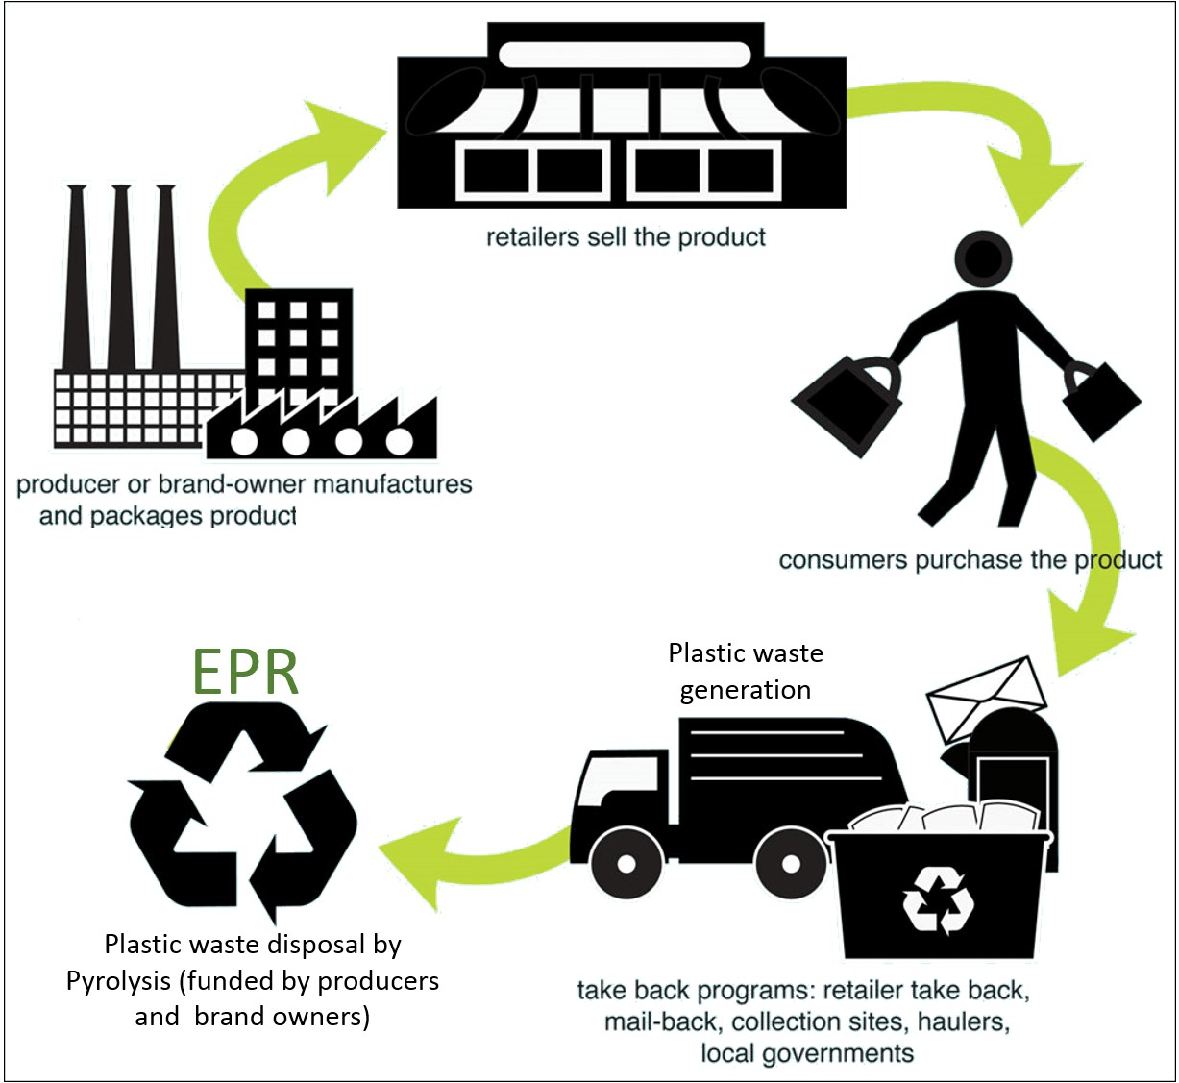
EXTENDED PRODUCER RESPONSIBILITY (EPR)
Extended producer responsibility (EPR), is an exercise and a policy method by which the producers take responsibility for the organization of the disposal of products they create Produce once those products are designated as not useful by consumers.
By making the manufacturer of the product responsible for the entire life- cycle of the product and especially for the take-back, recycling and final disposal.

Slide 9
The plastic waste consumer can be categorized as:
Pre-Consumer/Post-industrial Waste : It refers to the plastic waste that is generated within the industries during manufacturing and packaging processes and
Post- Consumer Waste: It refers to the plastic packaging discard including carry bags that are generated by consumers of the commodity.

Slide 10

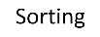
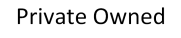
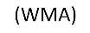
Flow chart for Pre-Consumer usage of Plastic Waste has been described below:
Generation
Industries
Non-Hazardous & unSorted
Non Hazardous & Sorted
Hazardous

Slide 11
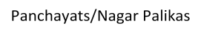
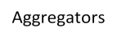
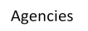

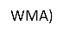


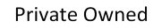
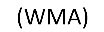
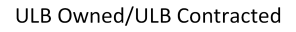
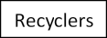
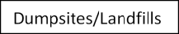
Flow Chart for Post-Consumer users Plastic Waste has been described below:
Households, markets, institutions, religious and other events
Generation
WMA- Biomining

Slide 12
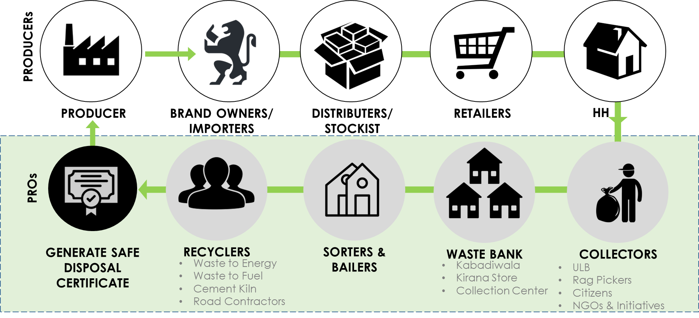
EPR

Slide 13
Producer is the umbrella term that includes Producers, Importers and Brand Owners. A producer is defined such that it includes any person/individual/industry who is:
The word Producer unless otherwise written would mean to include Producer, Importer and Brand Owner (PIBO)
Producer falling under point (a and b) needs to register as per FORM I- Part A to Regulators
Producers falling under point (c and b) and sell to other brand owners needs to register under FORM I- Part B to Regulators
Producers falling under point (c and d) and sell under own brand name needs to register as per FORM II to Regulators

Slide 14
Calculation For EPR Target (Producer):
Eligible Quantity in MT (Q 1) shall be
Q 1 (in MT) = (A + B) - C
- The average weight of plastic packaging material (category-wise and state wise) sold in the last two financial years
(B) - Average quantity of pre-consumer plastic packaging waste in the last two financial year
- The annual quantity supplied to the entities covered under sub-clause 4(iii) in the previous financial year.
Clauses 4 (iii) shall provide details of plastic packaging purchased from P and/or I

Slide 15
Calculation For EPR Target (Importer):
Eligible Quantity in MT (Q 2) shall be.
Q 2 (in MT) = (A + B) - C
(A) - The average weight of all plastic packaging material and / or plastic packaging of imported products (category-wise and state-wise) imported and sold in the last two financial years.
(B) - Average quantity of pre-consumer plastic packaging in the last two financial year.
(C) - The annual quantity supplied to the entities covered under sub-clause 4(iii) in the previous financial year.

Slide 16
Calculation For EPR Target (Brand Owner ):
Eligible Quantity in MT (Q 3)
Q 3 (in MT) = A + B
A: shall be the average weight of fresh plastic packaging material purchased and introduced in market in the last two financial years
B: average quantity of pre-consumer plastic packaging in the last two financial years.

Slide 17
Requirements under PWM Rules
Format by CPCB
Form 1
Format by CPCB
New
Half Yearly
Renewal of Registration after 1 Year
Registration
Action Plan submission
Progress Report
Submission

Slide 18
Roel Of Manufacturers and PIBOs
Manufacturers- Includes companies engaged in the business of manufacturing of plastic in the form of resin or manufacturing finished plastic packaging material.
PIBOs– companies using plastic packaging (primary as well as secondary packaging - including bottles, pouches, sachets, packets, jars, tubes etc. as well as industry using bubble- wraps and other such plastic material for wrapping).
Report details of plastic introduced into the market (type of plastic /quantity of plastic on a national basis to be uploaded into the Portal)
Meeting individually or collectively through the PROs/WMAs, recycling targets set by state, Union territories & central regulatory bodies Submit annual reports to CPCB/SPCBs as required.
Shall contribute to the EPR funds- as the case may be. The contribution shall be commensurate with the use of plastics in the country (for multi-state operators) or state, as the case may be.

Slide 19
Roles Of Recyclers
- Includes collection agencies, cement co-processors, Waste to Energy Plants, Road Construction mixers and other such recyclers/ recoverees of plastic as Condensed Boards
manufacturers.
Mandatory registration with the CPCB/ SPCB/ SPCCS as the case may be.
To approach the PROs with an efficient plan of recycling / recovering plastic and get funds from the EPR Corpus funds according to waste management scheme proposed.
Will drive efficiencies in the waste management initiatives.
Involve and uplift existing marginalized communities, currently involved in the waste management process (rag-pickers, etc.).

Slide 20
Roles Of Waste Management Agencies
NGOs, CBOs & Waste picker associations, individually are responsible for meeting the collection, segregation, recovery and recycling; meeting targets for the PRO and Manufacturers and Producers.
Establishing support from LBs for the allocation of space for creating Decentralized dry waste collection centers and Material Recovery Centre (MRF), with defined plant & machinery, infrastructure for collecting, secondary segregation and value addition sufficient volumes of waste using cost-effective business model arrangements.
Engage Waste Pickers (WPs) and create the opportunity for them to participate in the
formalized waste management systems having:
Adequate environmental, health and safe working conditions;
Occupational recognition, respect and dignity;
Appropriate and fair business models;
Auditing waste management operations; register MRF- SPCBs, letter of consent;
Promotes communication, education, Inclusion initiatives for Waste workers and other activities involving integration of Informal sector into the Formal sector.

Slide 21
Role Of CPCB
Set up institutional mechanism for management of EPR framework and its implementation.
Facilitates the startup of the PRO Advisory Committee (PROAC) and holding the Project Steering and the PRO Advisory Meetings.
Ensures that all Manufacturers and PIBOs and their partner PROs upload data in the portal. Devise penalties to non-complying by Manufacturers and PIBOs
CPCB to assign phased EPR targets as defined earlier for Manufacturers and PIBOs.

Slide 22
Role of SPCBs/PCB-UTs
States and UT PCBs shall participate in the Meetings of PROA on rotational basis in sync with the CPCB Guidelines
States shall implement the National EPR guidelines for Manufacturers and PBOs that are registered with them at the state/UT level and ensure governance as explained in the national/state framework

Slide 23
Responsibility of Producers, Importers and Brand Owners
Establish a system for collecting back the plastic waste generated due to their products.
Action plan of collection to be submitted to the State Pollution Control Boards while applying for Consent to Establish or Operate or Renewal.
Brand Owners whose consent has been renewed before the notification of these rules i.e. 18.03.2016 shall submit such plan within one year from the date of notification of these rules and implement with two years thereafter.

Slide 24
Responsibility of Producers, Importers and Brand Owners
The producer, within a period of three months from the date of final publication of these rules in the Official Gazette shall apply to the Pollution Control Board or the Pollution Control Committee, as the case may be, of the States or the Union Territories administration concerned, for grant of registration. Amended
to CPCB if operating in > 2 states and to SPCB if operating in < 2 states.
No producer shall on and after the expiry of a period of Six Months from the date of final publication of these rules in the Official Gazette manufacture or use any plastic or multi-layered packaging for packaging of commodities without registration from the concerned State Pollution Control Board or the Pollution Control Committees.

Slide 25

Responsibility of Producers, Importers and Brand Owners
Every producer shall maintain a record of details of the person engaged in supply of plastic used as raw material to manufacture carry bags or plastic sheet or like or cover made of plastic sheet or multi-layered packaging.

Slide 26








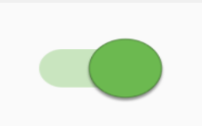

Post Approval
SPCB Will get Physical Audit Verification Request
By SPCB officials on Premises
Detail of Audit Form Will be Filled on premises
Value denomination will be created
Material Receipts
Production Details
Sale Receipts
Will be filled by PWP
Once Physical Verification is completed
Certificate Generation
Certificate Option will be Enabled
SMS Sent to PWP
PWP Wallet

Slide 27
Year selection
PIBO’S
Can trade Excess Credits between PIBO’s
Annual Return File
PIBO’s EPR target on Dashboard
Annua return will be submitted by PIBOS to concerned CPCB/SPCB
Based on Category
Procurement Annual Return
Registration Confirmation will be done by the SPCB
Can trade Excess Credits between PIBO’s
Annual return of PWP will be submitted using given format
PWP

